Slide 1
Not just talking, doing
D.I.B. Initiatives in English
By Alex Creighton (he/they)

Slide 2
What I refer to as The Conversation […] is a candid sharing of perspectives on race—grounded in facts—that leads to greater awareness, empathy, and action.
Dr. Robert Livingston, The Conversation

Slide 3
Multi-Pronged Approach
English 98r
(Junior Tutorial)
Department
Development Committee
English 350: Pedagogy Colloquium

Slide 4
English 98r
(Junior tutorial)
D.I.B. Resources / Ideas
Targeted Guidance

Slide 5
English 98r
(Junior tutorial)
D.I.B. Resources / Ideas
CURATION of existing material
  Peer syllabi
  Bok guidance
Diversity
  E.g., “Othello and Race”; gender theory and critical race theory.
Inclusion
  Transparency
  Inclusive learning statement
  Welcoming language
Targeted Guidance

Slide 6

Development
Committee
Pedagogy Series
Anti-racist pedagogy resources
Consultation
  Statement of values
  Inclusive syllabus resources
  Grad student liaison
  Future planning

Slide 7
English 350
(Pedagogy Colloquium)
Problem: How do you train new teachers to teach difficult or sensitive texts?

Slide 8
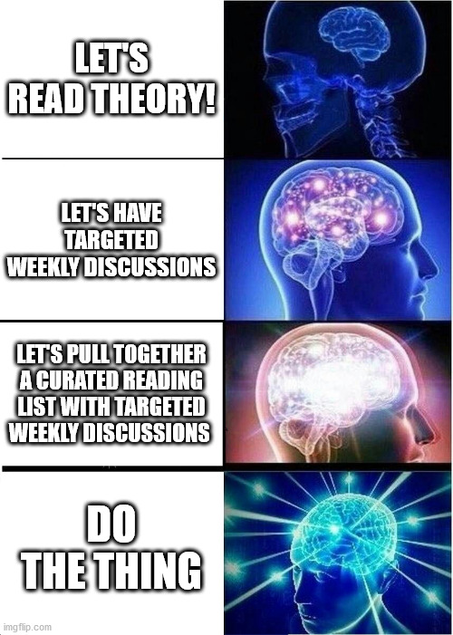
English 350
(Pedagogy Colloquium)
Problem: How do you train new teachers to teach difficult or sensitive texts?

